Slide 1
MASTER THEOREM
FOR
DIVIDE AND CONQUER
SUBTRACT AND CONQUER

Slide 2
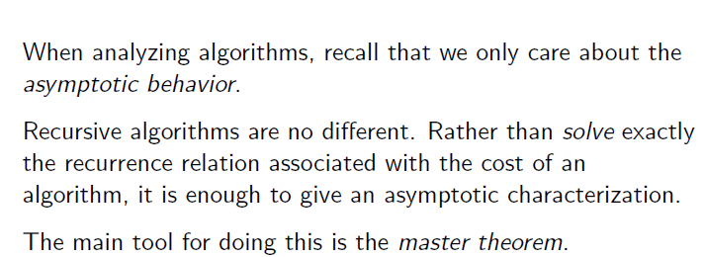
MASTER THEOREM

Slide 3
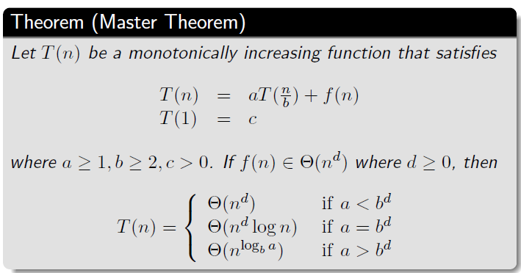
MASTER THEOREM

Slide 4
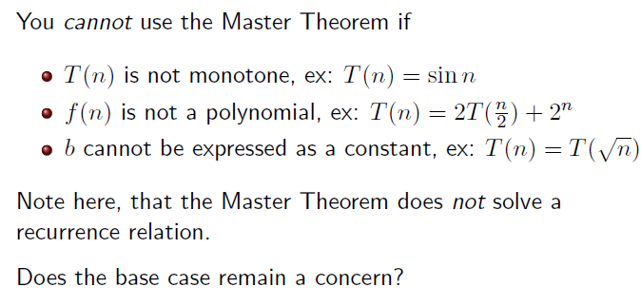
MASTER THEOREM

Slide 5
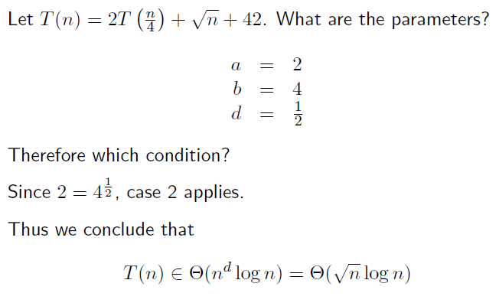
MASTER THEOREM

Slide 6
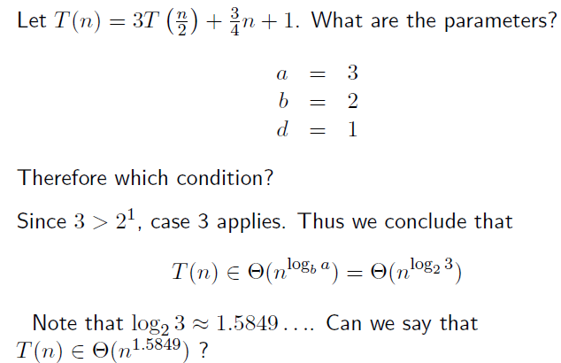
MASTER THEOREM

Slide 7
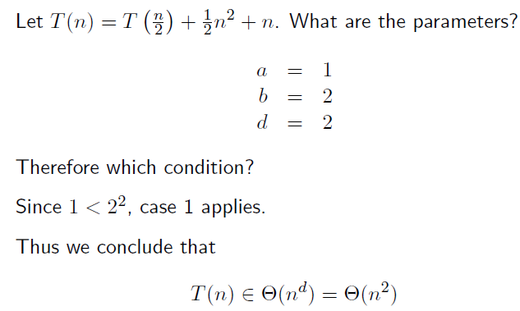
MASTER THEOREM

Slide 8
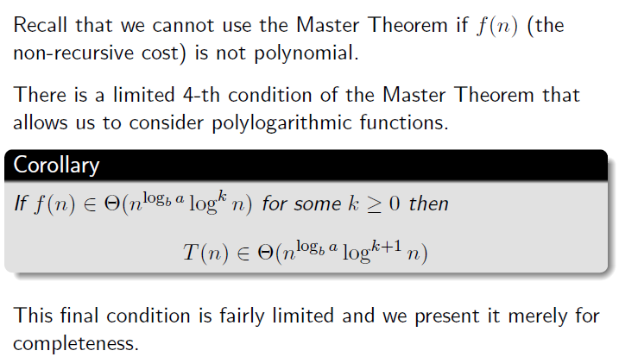
MASTER THEOREM – FOURTH CONDITION

Slide 9
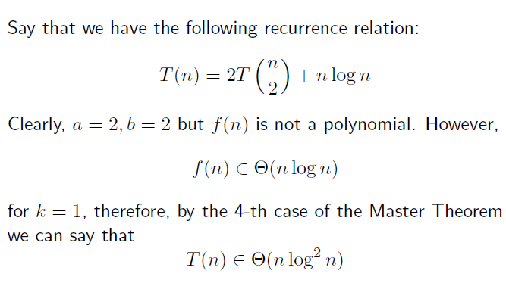
MASTER THEOREM

Slide 10
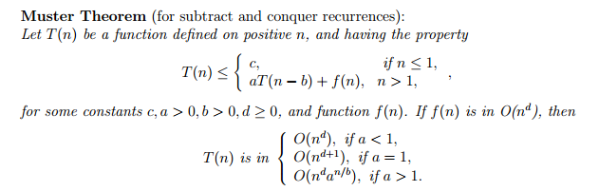
MASTER THEOREM – Subtract and Conquer

